Slide 1
The Science of Scientific & Technical Writing: How to Achieve Greater Control of Reader Interpretations

Slide 2
Agenda
Write with the Reader in Mind
Reader Expectations for the Structure of Scientific Writing
Subject-Verb Separation
The Topic Position
The Stress Position
Avoid the No. 1 Problem in Scientific Writing
How to Perceive Logical Gaps
Locating the Action
Writing and the Scientific Process

Slide 3
Write with the Reader in Mind

Slide 4
Write with the Reader in Mind
People assume reading science is hard
Readers do not simply read; they interpret
Readers must accurately perceive what the author had in mind
We need to know how readers go about reading
I will demonstrate rhetorical principles that produce clarity in communication without oversimplifying scientific concepts

Slide 5
Write with the Reader in Mind
Any piece of text may have 10 (or more) different meanings to 10 different readers
Readers make interpretive decisions based on clues they receive from the structure of text
Let’s look an example…

Slide 6


Write with the Reader in Mind
For example:
t(time)=15', T(temperature)=32º, t=0', T=25º; t=6', T=29º; t=3', T=27º; t=12',
T=32º; t=9'; T=31º
or
time (min) temperature(ºC)
0 25
3 27
6 29
9 31
12 32
15 32

Slide 7
Write with the Reader in Mind
Info is interpreted more easily when in places where readers expect to find it
The needs of the reader affect the interpretation not only of tables but also of the text itself
Readers have fixed expectations about where in the structure of text they encounter items of substance
You can therefore learn how to have better control over which data is emphasized

Slide 8
Write with the Reader in Mind
Readers have certain expectations for each “unit of discourse”
When these “units” are confused, readers are confused; readers search for info in certain places
If these structural expectations are violated, readers are forced to divert energy to unraveling structure
As the complexity of the context increases so does the possibility of misinterpretation

Slide 9
Reader Expectations for the Structure of Scientific Writing

Slide 10
Reader Expectations for the Structure of Scientific Writing
Here is our first example of scientific prose, in its original form:
“The smallest of the URF's (URFA6L), a 207-nucleotide (nt) reading frame overlapping out of phase the NH2-terminal portion of the adenosinetriphosphatase (ATPase) subunit 6 gene has been identified as the animal equivalent of the recently discovered yeast H+-ATPase subunit 8 gene. The functional significance of the other URF's has been, on the contrary, elusive. Recently, however, immunoprecipitation experiments with antibodies to purified, rotenone-sensitive NADH-ubiquinone oxido-reductase from bovine heart, as well as enzyme fractionation studies, have indicated that six human URF's (that is, URF1, URF2, URF3, and URF4, hereafter referred to as ND1, ND2, ND3, ND4) encode subunits of complex I. This is a large complex that also contains many subunits synthesized in the cytoplasm.”

Slide 11

Reader Expectations for the Structure of Scientific Writing
Why is this paragraph hard to read?
The technical vocabulary?
Maybe it requires specialized background knowledge?
Knowing a little about the subject matter does NOT clear up all the confusion
The reader is hindered by MORE than just the scientific jargon
Here is how we can fix these problems…

Slide 12
Subject-Verb Separation

Slide 13
Subject-Verb Separation
Look again at the first sentence of the passage
“The smallest of the URF's (URFA6L), a 207-nucleotide (nt) reading frame overlapping out of phase the NH2-terminal portion of the adenosinetriphosphatase (ATPase) subunit 6 gene has been identified as the animal equivalent of the recently discovered yeast H+-ATPase subunit 8 gene.”
There are structural problems here; info is not presented where readers need and expect to find it.

Slide 14
Subject-Verb Separation
Readers expect a grammatical subject to be followed immediately by the verb.
A stronger revision of our example text is: “The smallest of the URF's (URFA6L) has been identified as the animal equivalent of the recently discovered yeast H+-ATPase subunit 8 gene.”
Anything of length that intervenes between subject and verb is read as an interruption, and
therefore as something of lesser importance
The reader's expectation stems from a pressing need for syntactic resolution, fulfilled only by the arrival of the verb
Each unit of discourse is expected to serve a single function.

Slide 15
The Stress Position

Slide 16
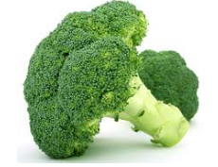
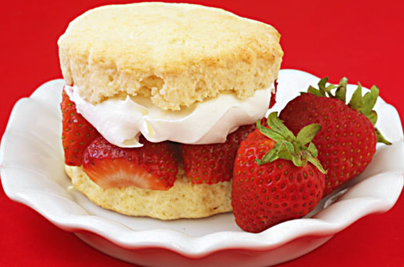

The Stress Position
It is a linguistic commonplace that readers emphasize the material that arrives at the END of a sentence
Writers can take advantage of this. As a result, the chances greatly increase that reader and writer will perceive the same material as being worthy of primary emphasis
The structure of the sentence thus helps persuade the reader of the relative values of the sentence's contents

Slide 17


The Stress Position
Long sentences increase chances the reader won’t interpret the text as the writer intended
The stress position should coincide with the moment of syntactic closure
Secondary stress positions can be formed using correct punctuation

Slide 18
Let’s Review…
We have now discovered 3 rhetorical principles based on reader expectations:
First: grammatical subjects should be followed as soon as possible by their verbs
Second: every unit of discourse, no matter the size, should serve a single function or make a single point
Third: info intended to be emphasized should appear at points of syntactic closure

Slide 19
Let’s Review…
Note the subject-verb separation in the 62-word third sentence of the original passage:
“Recently, however, immunoprecipitation experiments with antibodies to purified, rotenone-sensitive NADH-ubiquinone oxido-reductase [hereafter referred to as
respiratory chain NADH dehydrogenase or complex I] from bovine heart, as well as enzyme fractionation studies, have indicated that six human URF's (that is, URF1, URF2, URF3, URF4, URF4L, and URF5, hereafter referred to as ND1, ND2, ND3, ND4, ND4L and ND5) encode subunits of complex I.”
What’s wrong here?

Slide 20
Let’s Review…
When is a sentence too long?
A sentence is too long when it has more viable candidates for stress positions than there are stress positions available
No one should have to work hard to unearth the important content of a single passage!

Slide 21
The Topic Position

Slide 22
The Topic Position
In the stress position the reader needs and expects closure and fulfillment; in the topic position the reader needs and expects perspective and context
The information that begins a sentence establishes for the reader a perspective for viewing the
sentence as a unit. The TP refers to the beginning of the sentence
"Bees disperse pollen" vs "Pollen is dispersed by bees“
The topic position provides linkages

Slide 23
The Topic Position
“Large earthquakes along a given fault segment do not occur at random intervals because it takes time to accumulate the strain energy for the rupture. The rates at
which tectonic plates move and accumulate strain at their boundaries are approximately uniform. Therefore, in first approximation, one may expect that large ruptures of the same fault segment will occur at approximately constant time intervals. If subsequent main shocks have different amounts of slip across the fault, then the recurrence time may vary, and the basic idea of periodic mainshocks must be modified. For great plate boundary ruptures the length and slip often vary by a factor of 2. Along the southern segment of the San Andreas fault the recurrence interval is 145 years with variations of several decades. The smaller the standard deviation of the average recurrence interval, the more specific could be the long-term prediction of a future mainshock.”

Slide 24
The Topic Position
So what’s wrong with this text?
Let’s look closely at the information in each sentence's topic position:
Large earthquakes
The rates
Therefore...one
subsequent mainshocks
great plate boundary ruptures
the southern segment of the San Andreas fault
the smaller the standard deviation...
Writing that continually begins sentences w/
new information and ends w/ old information the end = bad

Slide 25

The Topic Position
Here is a revised version:
“Large earthquakes along a given fault segment do not occur at random intervals because it takes time to accumulate the strain energy for the rupture. The rates at which tectonic plates move and accumulate strain at their boundaries are roughly
uniform. Therefore, nearly constant time intervals (at first approximation) would be expected between large ruptures of the same fault segment. [However], the recurrence time may vary; the basic idea of periodic mainshocks may need to be modified if subsequent mainshocks have different amounts of slip across the fault. [Indeed], the length and slip of great plate boundary ruptures often vary by a factor of 2. [For example], the recurrence intervals along the southern segment of the San Andreas fault is 145 years with variations of several decades. The smaller the standard deviation of the average recurrence interval, the more specific could be the long term prediction of a future mainshock.”

Slide 26

The Topic Position
Our revised version is much easier to read!
We can see that most of our difficulty
was owing not to any deficiency in our reading skills but rather to the author's lack of comprehension of our structural needs as readers
Many authors rush to write down new ideas
They don’t revise their work; the structure becomes sloppy and they forget to consider how the reader processes info

Slide 27
Important Reminder
The No. 1 problem in professional writing today
is the misplacement of old and new information

Slide 28
Important Reminder
Let’s review…
In the topic position place the old information that links backward
In the stress position place the new information you want the reader to emphasize

Slide 29
How to Perceive Logical Gaps

Slide 30
Logical Gaps
When old information does not appear at all in a sentence readers are left to construct the logical linkage by themselves (not ideal!)
“The enthalpy of hydrogen bond formation between the nucleoside bases 2'deoxyguanosine (dG) and 2'deoxycytidine (dC) has been determined by direct measurement. dG and dC were derivatized at the 5' and 3' hydroxyls with triisopropylsilyl groups to obtain solubility of the nucleosides in non-aqueous
solvents and to prevent the ribose hydroxyls from forming hydrogen bonds. From isoperibolic titration measurements, the enthalpy of dC:dG base pair formation is -6.65±0.32 kcal/mol.”
Each sentence must proceed logically from its predecessor!

Slide 31
Locating the Action

Slide 32
Locating the Action
So where do we start when making revisions?
Attending to any one structural problem eventually leads us to all the others
-Look at the topic sentences
-Make a list of the verbs in the paragraph
-Remember: The fewer the structural clues to interpretation given by the author, the more variable the resulting interpretations will tend to be
As critical scientific readers, we need to concentrate our energy on whether the experiments prove the hypotheses

Slide 33
Writing & the Scientific Process

Slide 34



Writing & the Scientific Process
Remember the following structural principles:
1. Follow a grammatical subject as soon as possible w/ its verb.
2. Place “important information" in the stress position.
3. Place "old information" in the topic position for linkage backward and contextualization forward.
4. Provide context for your reader before asking that reader to consider anything new.

Slide 35
Writing & the Scientific Process
A few points to wrap up…
-Don’t slavishly follow rules
-Rules can occasionally be broken…for a good reason!
-Reverse bad habits that burden readers
The substance of science comprises more than the discovery and recording of data; it extends crucially to include the act of interpretation
Remember: The structure influences the reader
Think: Does your writing help or hinder the reader?

Slide 36

About Accdon / LetPub
English Language Editing
Expert Scientific Editing
Professional Translation
Manuscript Formatting
We help international researchers eliminate language barriers and see their work recognized and published in premium peer-reviewed journals.
All of our language editors are native English speakers with long-term experience in editing scientific and technical manuscripts.
All of our expert scientific editors have substantial experience in their respective fields and proven track records in scientific publication.
Many of our editors are active peer reviewers and have served as journal editors.
25,000+ papers
500+ editors
5 years of experience

Slide 37


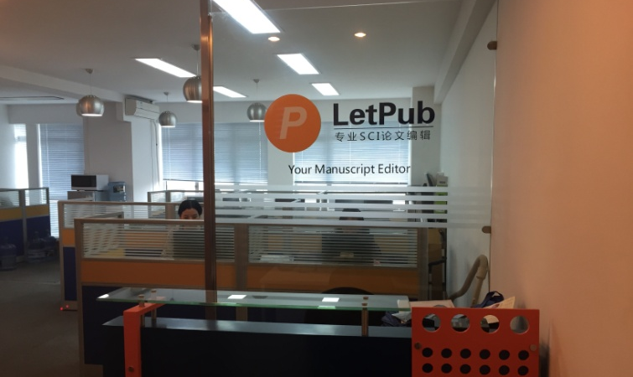
Where We Are
We strive to level the playing field for clients across the globe.
Main office in Massachusetts
Office in Shanghai
Global talents: Most of our editors were educated and have research supervision experience at top universities and research institutions in the U.K. and U.S.A.
Local services: We service clients from Asia and the Pacific through our Shanghai office for easy communication.
Details at: www.letpub.com

Slide 38
About Accdon / LetPub
Request a copy of this presentation at:
Support @letpub.com

